Slide 1

AgriIntelligence – An End-to-End Crop, Weather & Market Analytics Platform
Final Project Review | Department of CSE | KLH University
TEAM MEMBERS
2420030290 – D Kamal
2420030291 – V Chandra
2420030461 – G Khethana
Guide: B Prathusha Assistant Professor | Academic Year: [2026–27]
Notes:
Title slide. Replace all bracketed text. Use the full project title, list every team member with registration number, and name your guide. Insert the institution logo in the dashed box.

Slide 2




Introduction & Problem Statement
[Insert domain image, real-world scenario or problem illustration]
Background
Agriculture plays an important role in food production and the economy.
Crop yield is influenced by rainfall, temperature, pesticide usage and crop selection.
Agricultural market prices also provide useful information for decision-making.
Problem Statement
Crop, environmental and market information is available in separate datasets.
An integrated platform is needed to analyze agricultural factors and predict crop yield.
Motivation / Need
Simplify agricultural data analysis.
Understand the relationship between agricultural factors and crop yield.
Provide an interactive platform for crop analytics, market analysis and yield prediction.
Notes:
State the domain, the exact problem and why it matters. Keep it to about 2 minutes. Add one real-world statistic if you can, with a citation.

Slide 3

Objectives & Scope
Objectives
1
Integrate crop yield and agricultural market datasets.
2
Clean and preprocess agricultural data for analysis.
3
Analyze the relationship between rainfall, temperature, pesticide usage and crop yield.
4
Develop a Random Forest Regression model for crop yield prediction.
5
Build an interactive Streamlit dashboard.
Notes:
Objectives should be measurable and start with action verbs. The scope slide tells the panel what you did and did not attempt.

Slide 4

Literature Survey
S.No | Author(s) & Year | Method / Technique | Key Findings | Limitation / Gap
1 | van Klompenburg et al. (2020) | Systematic review of ML and deep learning methods | Rainfall, temperature and soil type are commonly used for crop-yield prediction. | Reviews existing studies but does not provide one integrated agricultural analytics platform.
2 | Elavarasan et al. (2018) | Decision Tree, Random Forest, SVM, ANN and other ML methods | ML techniques can analyse climate and agricultural factors for yield prediction. | Focuses on reviewing prediction techniques rather than integrating yield and market analysis.
3 | Thimmegowda et al. (2023) | Simple Multiple Linear Regression and Artificial Neural Network | ANN showed better rice-yield prediction performance than SMLR in the Karnataka study. | Focuses on rice in selected Karnataka districts; results may not generalise to all crops and regions.
4 | Mahajan et al. (2026) | Random Forest, Extra Trees, Gradient Boosting and XGBoost | ML models performed better than the seasonal-naive benchmark for agricultural commodity prices. | Uses historical prices; external factors such as weather and production were not included.
Research Gap
Existing studies mainly focus on individual areas such as crop-yield prediction, weather-based forecasting or agricultural market-price analysis. There is a need for an integrated platform that combines crop, weather, agricultural-factor and market data in one place. AgriIntelligence addresses this gap by providing crop and market analytics, visualisations, and machine-learning-based crop-yield prediction through a single Streamlit dashboard.
Notes:
Summarise four to six relevant papers or existing systems. End with the research gap, because that gap justifies your project.

Slide 5





Proposed System & Methodology
STEP 1
STEP 2
STEP 3
STEP 4
STEP 5
Data Collection
Data Preprocessing
EDA
Model Development
Dashboard Development
Inspect data types, missing values and duplicate records.
Rename columns and convert required data types.
Analyze crop distribution and average yield.
Study agricultural factors and market prices.
Apply Linear Regression and Random Forest Regression.
Train and evaluate the prediction model.
Load crop and agricultural market datasets from CSV files.
Integrate the saved model with Streamlit.
Display analytics and crop yield predictions.
Key Novelty / Contribution
AgriIntelligence integrates crop-yield prediction, weather analysis, agricultural-factor analysis, and market-price analytics into a single interactive platform. Unlike approaches that focus on individual agricultural aspects, our system combines these insights with a Random Forest Regression model to support data-driven agricultural decision-making.
Notes:
Walk through the five steps left to right. Rename the steps to match your project (for example, Requirement Analysis, Design, Coding, Testing, Deployment). End with your novelty.

Slide 6
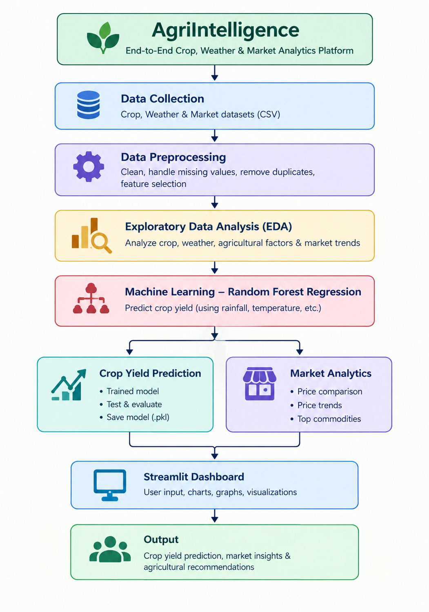
System Architecture
[Insert system architecture / block diagram
(Input → Processing → Output)]
Components
1
Data Sources
Crop and market CSV datasets
2
Preprocessing
Cleaning and transformation
3
Analytics & ML
Visualization and prediction
4
User Interface
Streamlit dashboard
Notes:
Insert a clear block diagram: input, processing, storage, output. Number each block and explain them on the right. Redraw the figure yourself rather than copying it.

Slide 7


Hardware & Software Requirements
Hardware
Software & Tools
Libraries / Frameworks
Processor: Standard laptop or desktop processor.
RAM: Sufficient memory to load and process the datasets.
Storage: Space for datasets, source code, trained model and results.
Network: Internet connection for software installation, if required.
Operating System: Windows.
Programming Language: Python.
IDE: Visual Studio Code.
Notebook: Jupyter Notebook.
Pandas
NumPy
Matplotlib
Seaborn
Scikit-learn
Joblib
Streamlit
Deployment / Platform: Local Machine – Python-based Streamlit Web Application.
Notes:
List only what you actually used, with versions. For a pure software project, shorten the hardware list and add cloud or deployment resources.

Slide 8
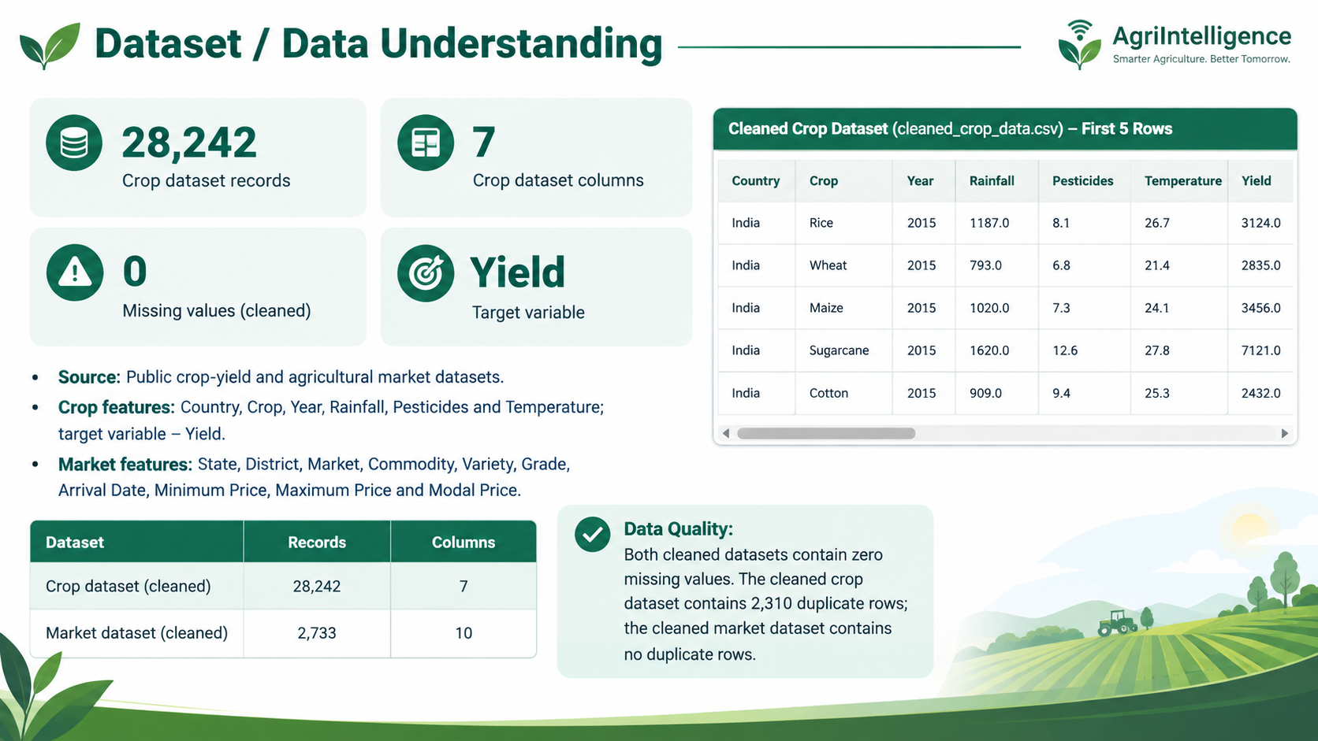

Slide 9
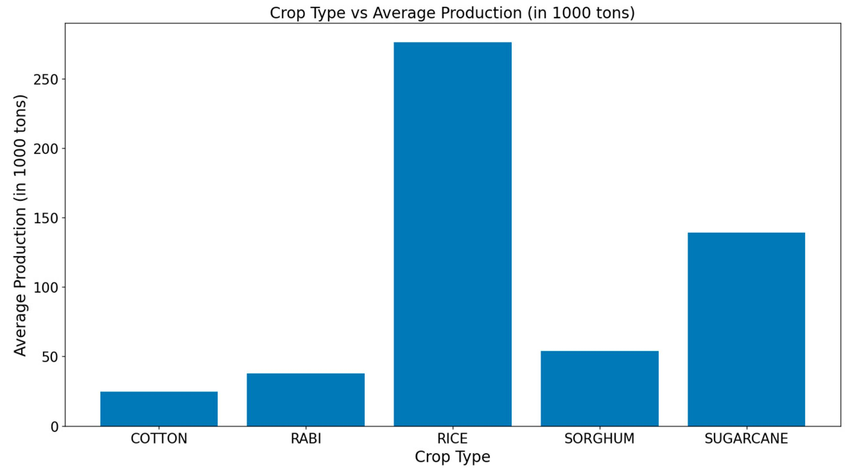
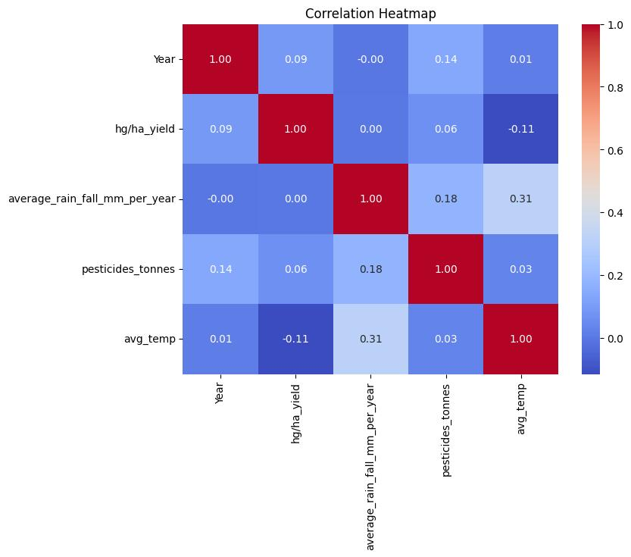



Data Preprocessing & Exploratory Analysis
[Insert feature distribution / histogram]
[Insert correlation heatmap / outlier box-plot]
Cleaning
Transformation
Feature Selection
Removed records with missing important market values.
No specific duplicate or outlier removal applied.
One-Hot Encoding for Country and Crop.
No scaling or normalization applied.
6 input features: Country, Crop, Year, Rainfall, Pesticides and Temperature.
Target variable: Yield.
Notes:
Show two or three plots that tell a story: distributions, correlations, outliers. Explain what each plot told you and what you did about it.

Slide 10
Module-wise Description
1
Crop Analytics
2
Weather Analytics
Purpose: Analyze crop productivity and compare average yields.
Input → Output: Crop dataset → Crop yield charts and comparisons.
Developed by: D Kamal
Purpose: Analyze rainfall and temperature relationships with crop yield.
Input → Output: Rainfall and temperature → Weather analysis graphs.
Developed by: V Chandra
3
Agricultural Factors
4
Market Analytics
Purpose: Examine pesticide usage and agricultural factor correlations.
Input → Output: Agricultural data → Correlation charts and insights.
Developed by: G Khethana
Purpose: Analyze commodity prices and market trends.
Input → Output: Market dataset → Price comparisons and trend charts.
Developed by: G Khethana
Notes:
Divide the project into three to five modules. For each, state its purpose, inputs, outputs and who built it. Duplicate a card if you have more modules.

Slide 11

Algorithms & Technologies Used
Random Forest Regression
Linear Regression
One-Hot Encoding
Why chosen
Provides strong prediction performance and handles complex relationships.
Key parameters
100 trees, random state = 42.
Why chosen
Used as a baseline model for comparison.
Key parameters
Default Scikit-learn configuration.
Why chosen
Converts categorical data into numerical format.
Key parameters
Country and Crop; handle_unknown="ignore".
Selection criteria: Random Forest Regression was selected for the final crop-yield prediction model based on its evaluation results, achieving an R² score of 0.987643 (98.76%).
Notes:
Name each model, algorithm or technology, say why you chose it, and list the key settings. Then explain how you picked the final one.

Slide 12
Implementation / Model Building
Feature Selection
Code snippet / pseudocode
Country, Crop, Year, Rainfall, Pesticides, Temperature
Target: Yield
rf_model = Pipeline([
("preprocessor", preprocessor),
("model", RandomForestRegressor(
n_estimators=100,
random_state=42,
n_jobs=-1
))
])
rf_model.fit(X_train, y_train)
rf_pred = rf_model.predict(X_test)
joblib.dump(
rf_model,
"../src/crop_yield_model.pkl"
)
Preprocessing Pipeline
Country and Crop are encoded using One-Hot Encoding.
Numerical features are passed through the pipeline.
A Scikit-learn Pipeline combines preprocessing and model training.
Data Splitting
Training data: 80%
Testing data: 20%
Random state: 42
Configuration
Algorithm: Random Forest Regression
Number of estimators: 100
Random state: 42
Notes:
Describe the build in the order you did it. Paste only the most important code or pseudocode, not entire files. For hardware projects, show the circuit or wiring summary instead.

Slide 13
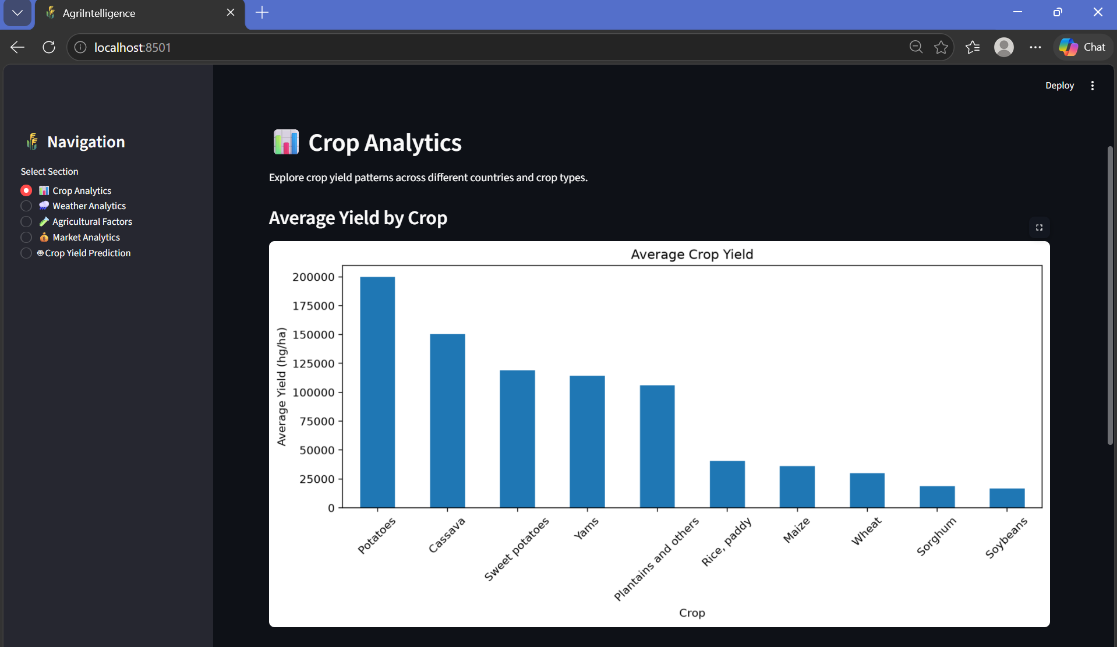
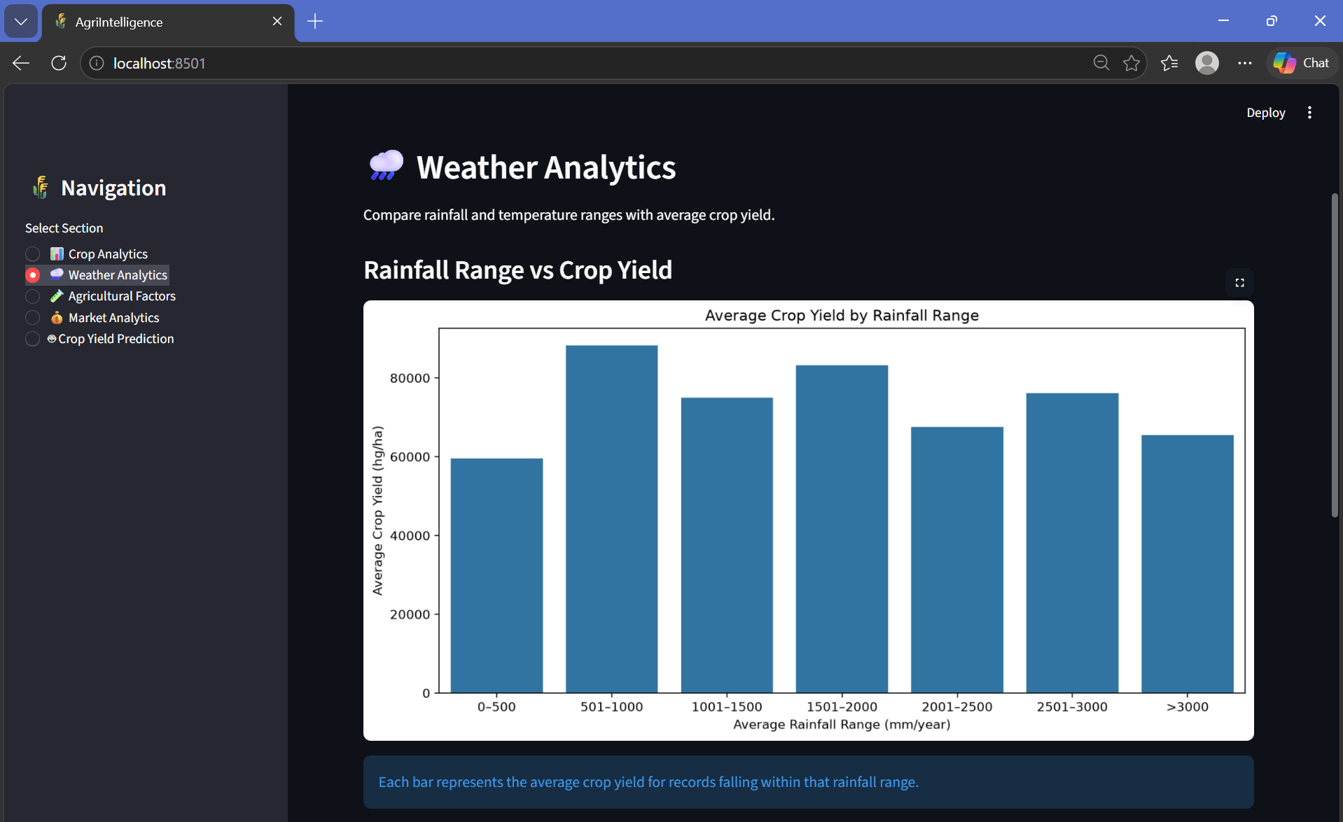
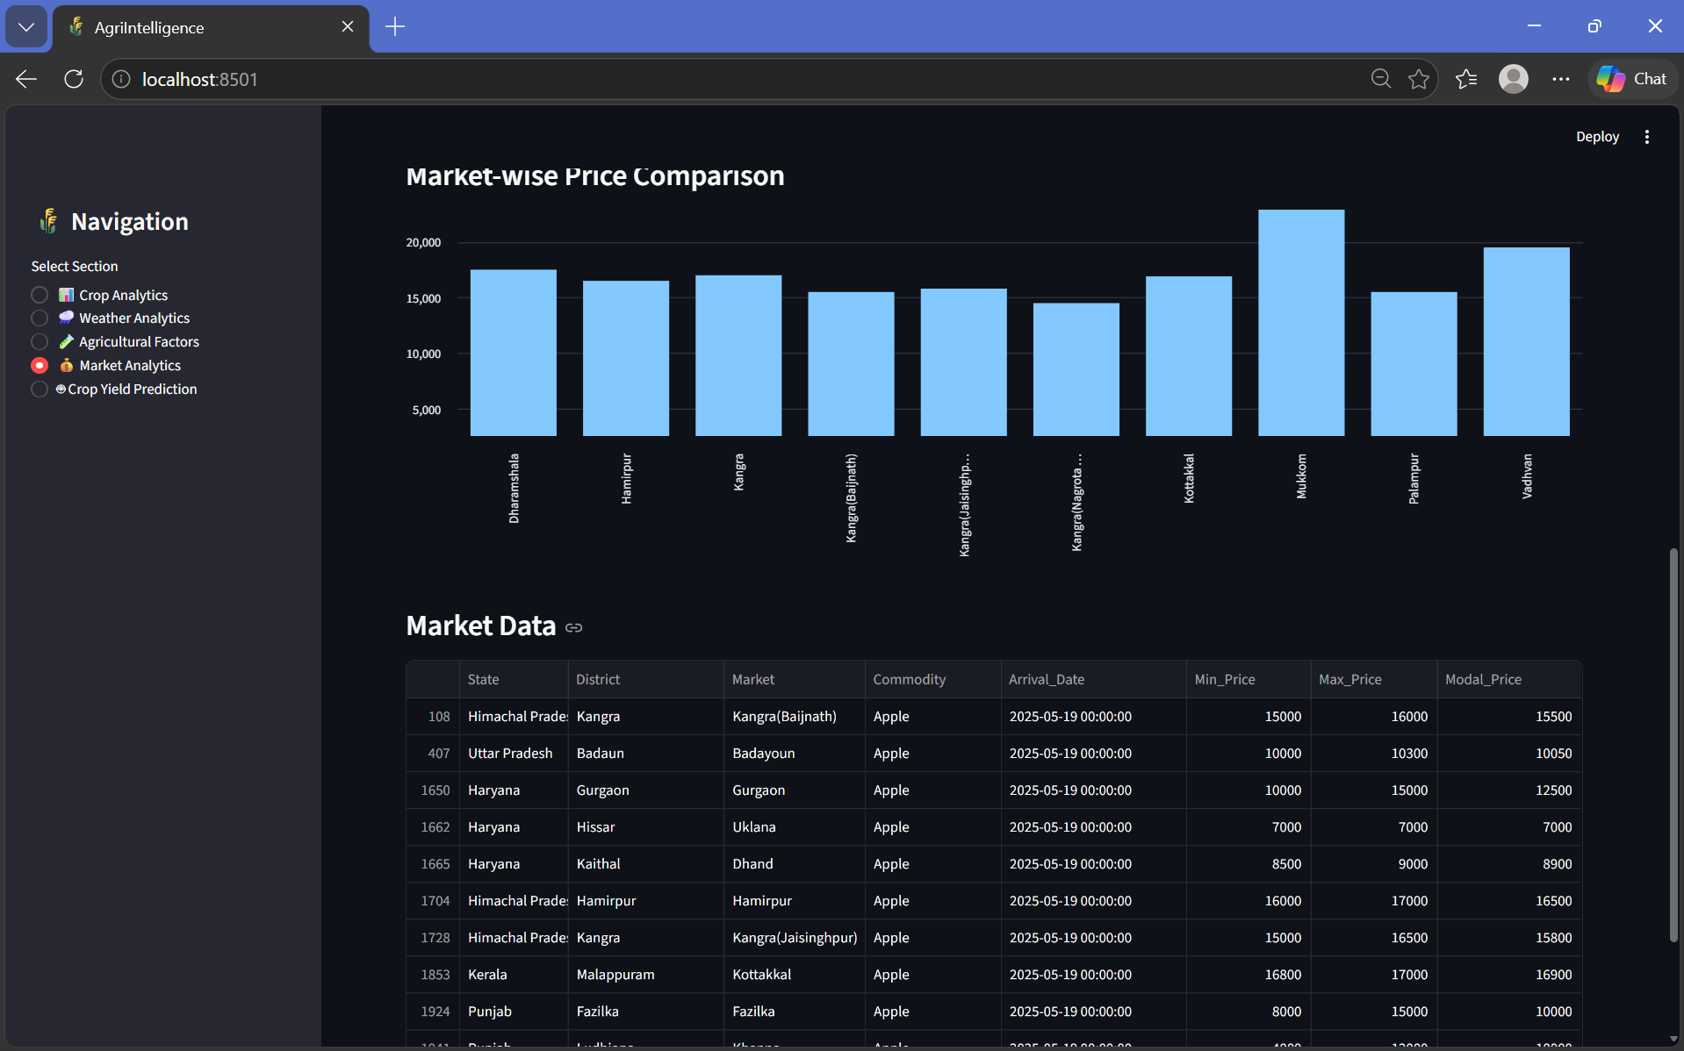
Working Prototype / Output Screens
[Screenshot / photo 1]
[Screenshot / photo 2]
[Screenshot / photo 3]
Crop Analytics
Weather Analytics
Market Analytics
Notes:
Show real screenshots, photos of the hardware or a short demo video link. Caption each one with what the viewer should notice.

Slide 14
Results & Performance Comparison
Metric | Recorded value
Mean Absolute Error (MAE) | 3466.6454
Mean Squared Error (MSE) | 89633723.9258
Root Mean Squared Error | 9467.5089
R² Score | 0.987643
Best recorder result:
R² = 0.987643 | 98.76% on the evaluated test split
Notes:
Right-click the chart and choose Edit Data to enter your real numbers. Replace the metrics with the ones that fit your project (accuracy, latency, power, throughput, user rating). State clearly which option performed best.

Slide 15
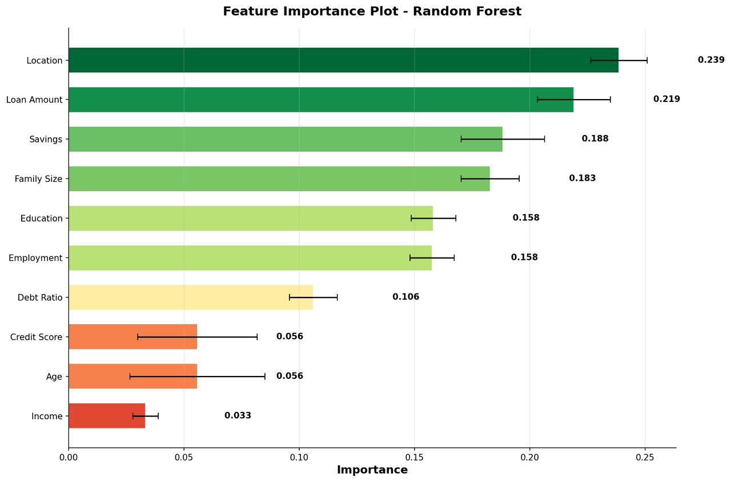
Analysis & Key Findings
[Insert confusion matrix / feature importance /
ROC curve / output comparison]
98.76%
R² Score – Random Forest Regression Model
Interpretation: The Random Forest model achieved an R² score of 98.76%, indicating a strong fit between actual and predicted crop yields.
Error analysis: Prediction errors are measured using MAE and RMSE. Differences may occur due to variations in environmental and agricultural conditions.
Key drivers: Country, Crop, Year, Rainfall, Pesticides and Temperature are the input features used for crop yield prediction.
Notes:
Explain what the numbers mean. Use a confusion matrix, ROC curve, feature-importance chart or output comparison. Be honest about weak results; panels value that.

Slide 16

Testing & Validation
Test ID | Test Description | Expected Result | Actual Result | Status
TC-01 | Dataset Loading | Dataset loads successfully | Verify execution | To Verify
TC-02 | Data Preprocessing | Data is cleaned and prepared | Verify execution | To Verify
TC-03 | Crop Yield Prediction | Model generates a yield estimate | Verify execution | To Verify
TC-04 | Dashboard Testing | All modules display correctly | Verify execution | To Verify
Functional Testing
Validation Method
Performance Testing
Dataset loading, preprocessing, prediction, and dashboard navigation
Training and testing data split and model evaluation
MAE, MSE, RMSE, and R² evaluation
Notes:
List representative test cases with expected and actual outcomes. Name the validation methods you used. Delete rows you do not need.

Slide 17


Challenges & Limitations
Challenges Faced
Limitations
Handling missing and inconsistent data.
Integrating datasets with different structures.
Preparing categorical features for machine learning.
Presenting multiple agricultural indicators clearly.
Results depend on dataset quality.
Performance may differ on unseen data.
Yield predictions are estimates, not guarantees.
Real-time weather integration and market forecasting are potential enhancements.
Notes:
Be candid. Pair every challenge with how you solved it, and list limitations that the panel would otherwise spot themselves.

Slide 18

Conclusion
Final Outcome
Developed AgriIntelligence, an integrated agricultural analytics platform.
Analyzed crop yield, weather conditions, agricultural factors and market prices.
Performed data preprocessing and exploratory data analysis.
Built a Random Forest Regression model for crop-yield prediction.
Developed an interactive Streamlit dashboard.
[98.76%]
R² Score
MAE: 3,466.65
RMSE: 9,467.51
Notes:
Revisit each objective and say whether you met it. Quote your headline result with numbers. Do not introduce new material here.

Slide 19



Future Scope & Applications
Improve Performance
Tune the Random Forest model for better prediction performance.
Explore additional machine-learning algorithms.
Applications
Crop-yield estimation and agricultural planning
Agricultural market-price analysis
Support for farmers, researchers and agricultural analysts
Expand Data / Features
Integrate real-time weather data.
Include more crops, regions and agricultural parameters.
Deploy & Build an Interface
Deploy the dashboard as a web application.
Develop a mobile-friendly interface.
Scale & Secure
Improve data storage and processing.
Add secure cloud-based access.
Notes:
Give concrete next steps, ideally tied to the limitations. Then name two or three real-world uses.

Slide 20
Team Contribution
Reg. No. | Name | Contribution / Modules Handled
2420030290 | D Kamal | Dataset Collection, Data Preprocessing and Integration
2420030291 | V Chandra | Exploratory Data Analysis, Weather and Market Analytics
2420030461 | G Khethana | Machine Learning Model, Crop Yield Prediction, Streamlit Dashboard and Report Preparation
Notes:
Show that work was planned and shared. Every member should be able to explain their own module.

Slide 21

References
Python Software Foundation, Python Documentation. https://docs.python.org/3/
Pandas Development Team, Pandas Documentation. https://pandas.pydata.org/docs/
NumPy Developers, NumPy Documentation. https://numpy.org/doc/
Matplotlib Development Team, Matplotlib Documentation. https://matplotlib.org/stable/
Seaborn Developers, Seaborn Documentation. https://seaborn.pydata.org/
Scikit-learn Developers, Scikit-learn Documentation. https://scikit-learn.org/stable/
Streamlit, Streamlit Documentation. https://docs.streamlit.io/
T. V. Klompenburg et al., Crop Yield Prediction Using Machine Learning: A Systematic Literature Review.
D. Elavarasan et al., Forecasting Yield by Integrating Agrarian Factors and Machine Learning Models.
K. R. Prasad et al., Weather-Based Statistical and Neural Network Tools for Forecasting Rice Yields in Major Growing Districts of Karnataka.
Project Links
GitHub: https://github.com/Ganta-khethana/DS_S7_T18_AgriIntelligence/tree/main/Project
Dataset:
Crop Yield Dataset: https://www.kaggle.com/datasets/patelris/crop-yield-prediction-dataset
Agricultural Market Dataset: https://www.data.gov.in/catalog/current-daily-price-various-commodities-various-markets-mandi
Demo video: https://drive.google.com/file/d/1-PMitvPvyQFfJBKckiKpf7LZBF9JSao_/view?usp=sharing
Notes:
Use IEEE style, numbered in order of first citation in the deck. Include datasets, documentation and code repositories.

Slide 22
THANK YOU
Section 7
Team 18
B Prathusha /Assistant Professor
Department of Computer Science and Engineering
Notes:
Leave this slide up during questions. Make sure every team member can answer questions about their own module.

